Slide 1


Slide 2


Slide 3
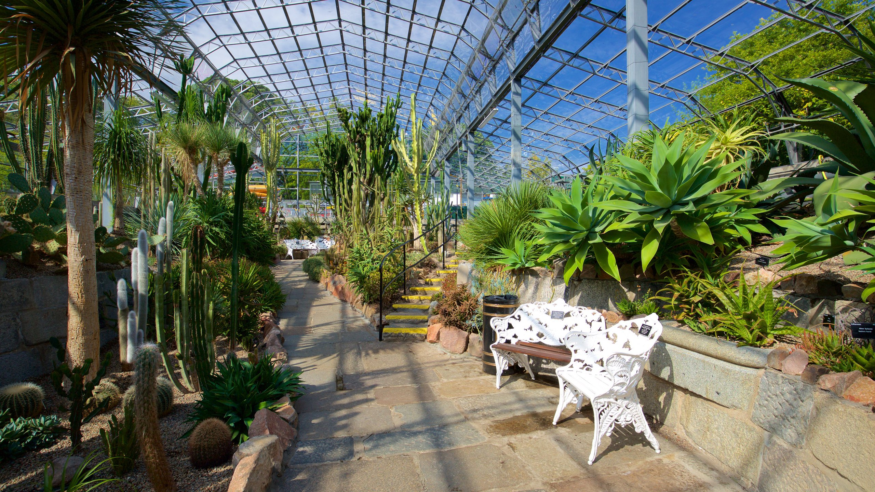
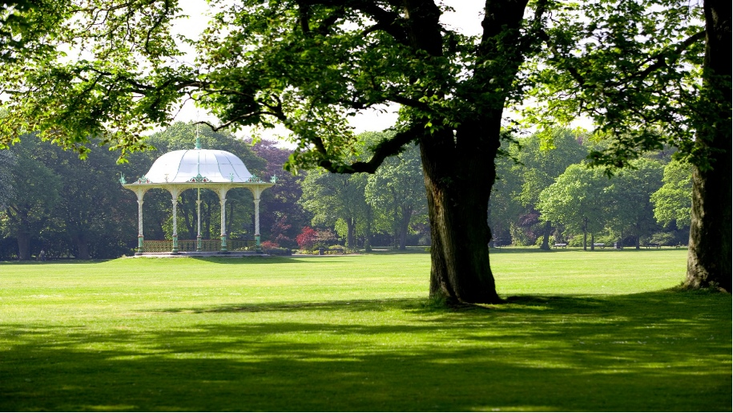
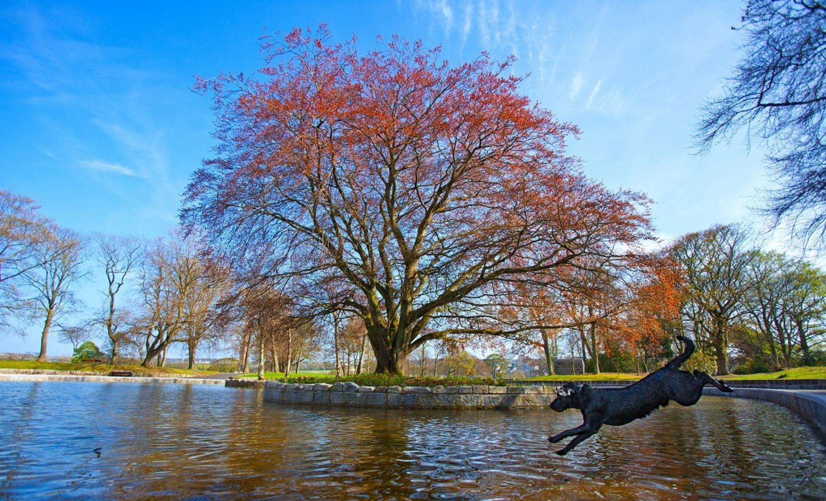
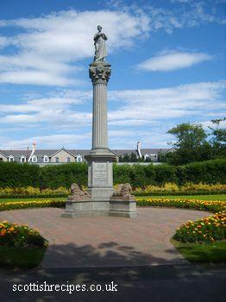
Duthie Park

Slide 4
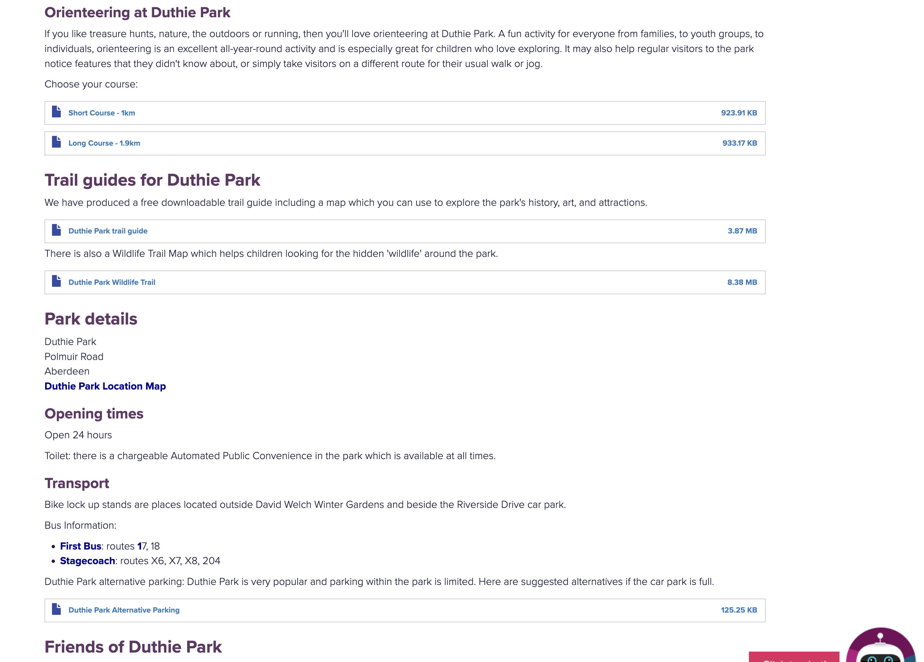
Duthie Park
https://www.aberdeencity.gov.uk/services/leisure-culture-and-parks/parks-and-gardens/duthie-park

Slide 5
Whats a pdf?

Slide 6
We need a
Duthie Park App

